Slide 1
Object Oriented Programming
(OOP)
Dec, 2013
Tin Bui

Slide 2
What is OOP?
OOP is a programming language model organized around “objects” that have data and methods.

Slide 3
Class and Object
A class is the blueprint from which individual objects are created
  E.g. Employee is class. A employee with name Simon is an object of class Employee
  Employee simon = new Employee();
Instance is the actual object created at runtime

Slide 4
Class and Object
Object Type
Reference Type
A a = new B();
Reference

Slide 5
Class' field or method
A field or method with static modifier
Can access directly from class without creating instance

Slide 6
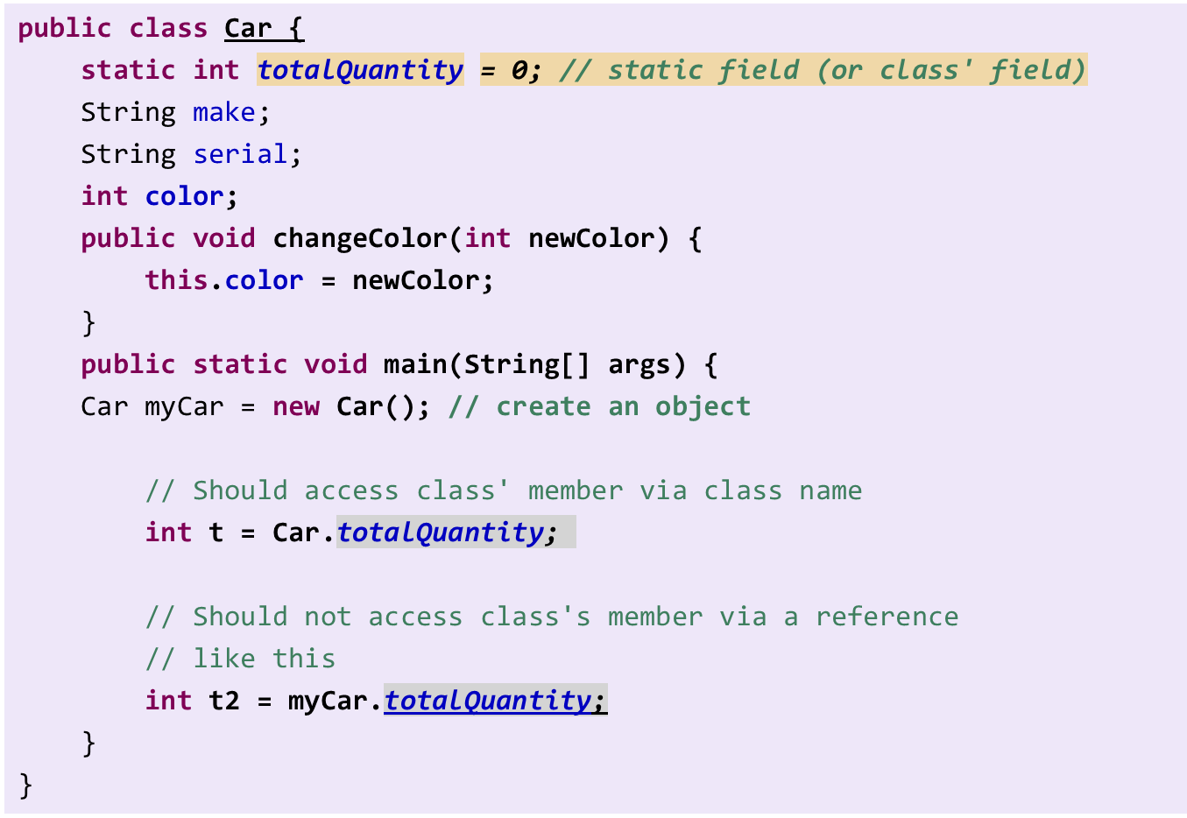
Class Example

Slide 7
Benefit of OOP
Reusability of code
  Classes can be used by several applications.
Modularity of code
  An object can be maintained independently of other objects
Resilience to change
Information hiding
  Only a limited access to information is provided
Real World Programming

Slide 8
OOP Concepts (or Characteristics)
Encapsulation
Inheritance
Abstraction
Polymorphism

Slide 9

Encapsulation
A technique used for hiding the properties and behaviors of an object and allowing outside access only as appropriate.
It prevents other objects from directly altering or accessing the properties or methods of the encapsulated object.

Slide 10
Access control modifiers
private
  private members are accessible only in the class itself
package
  package members are accessible in classes in the same package and the class itself
protected
  protected members are accessible in classes in the same package, in subclasses of the class, and in the class itself
public
  public members are accessible anywhere the class is accessible

Slide 11
Abstraction
A process of hiding the implementation details and showing only functionality to the user
Abstraction lets you focus on what the object does instead of how it does

Slide 12
Abstraction
Abstract Methods
Abstract Classes
Interfaces

Slide 13
Interface
Interfaces are abstract
Its members are public
Methods are abstract
Fields are static final
interface Speakable {
int VIETNAMESE = 1;
int ENGLISH = 2;
int ESPERANTO = 3;
void speak();
}
abstract interface Speakable2 {
public static final int VIETNAMESE = 1;
public static final int ENGLISH = 2;
public static final int ESPERANTO = 3;
public abstract void speak();
}

Slide 14
Interface Implementation
interface A {
void do1();
}
class B {
public void do1() {
}
}
class C extends B implements A {
}
Do we need
an implementation
of do1() here?
No! do1()
is implemented by B,
so it satisfies A

Slide 15
Inheritance
A mechanism in which one object acquires all the properties and behaviour of another object of another class

Slide 16
Inheritance
Enables you to extend the functionality of an existing class.
Enables you to add new features and functionality to an existing class without modifying the existing class.
Enables you to share data and methods among multiple classes
Inheritance:
  Extends (used for classes → classes, interfaces → interfaces)
  Implements (used for classes → interfaces)

Slide 17
Polymorphism
Polymorphisms means 'many shapes'
Polymorphism describes a pattern in object oriented programming in which classes have different functionality while sharing a common interface.
Polymorphism is a feature that allows values of different data types to be handled using a uniform interface

Slide 18
Override and Overload
Override
  Re-implement a method of a super class
Overload
  Define methods with the same name but different parameters
  Can be either in the same class or a super-sub classes hierarchy

Slide 19
Abstract Class
May or may not have abstract method
Cannot create instance
Does abstract class has constructors?
  Why?

Slide 20
Object creation and casting
Given:
What happens with these statements?
  B b = new C();
  C c = (C) b;
A
C
B
A
B
b
C
c

Slide 21
Polymorphism
A
X f()
A[] as = new A[3];
as[0] = new A[];
as[1] = new B[];
as[2] = new C[];
as[1].f(); // which f() will be invoked?
as[2].f(); // which f() will be invoked?
B
X f()
C
X f()
☞
The overriding method in the actual instance will be invoked

Slide 22
Polymorphism
A
A[] as = new A[3];
as[0] = new A[];
as[1] = new B[];
as[2] = new C[];
B b = as[2];
// which i will be referred?
as[1].i;
as[2].i;
b.i
i : int
B
i : int
C
i : int
☞
No polymorphism applied for fields
Never public any field. Use getter/setter instead

Slide 23
Coupling And Cohesion
Coupling
  How classes interact with each other
Cohesion
  The degree to which a class/module has a single, well-focused purpose

Slide 24
Best OO Design
Tight encapsulation
Loose coupling
High cohesion

Slide 25
References
SCJP Sun Certified Programmer for Java 6 Exam 310-065

Slide 26
Thank you!

